Slide 1

Intro to Tableau Workshop
Google Drive Link: https://tinyurl.com/IntroToTableauF2024
Reeshad Mohammed & Benjamin Yu

Slide 2


About the Presenters
Reeshad
Mohammed
Benjamin Yu
Workshop Co-Chair
Data Theory Major
Workshop Co-Chair
Statistics and Data Science & Applied Math Majors, Digital Humanities Minor

Slide 3
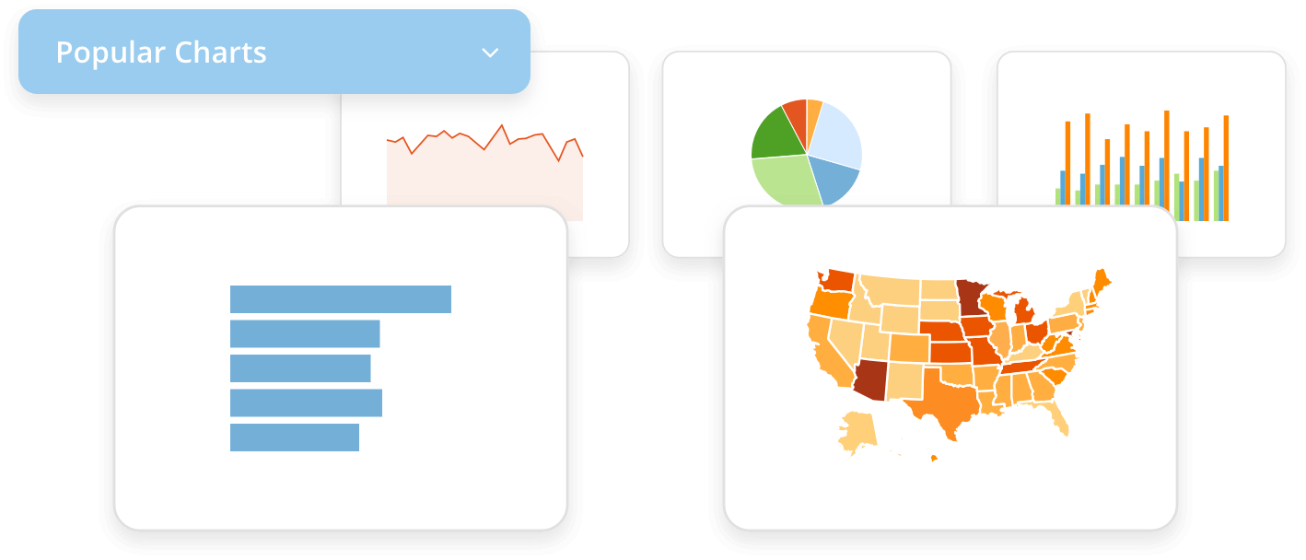
Introduction
What is data visualization?
Data visualization converts raw data and information into a easy to interpret form, which helps with understanding and finding patterns in data. These patterns are crucial to making conclusions about the data at hand.
Tableau is a tool that can help create effective and clear data visualizations

Slide 4

Tableau
Tableau is an application with many data visualization capabilities, of which some will be featured today such as bar charts, line graphs, and maps
Tableau allows for data from csv files, sheets and much more to be imported, making it a versatile tool
If you haven’t downloaded with the instructions sent in advance, we will give you a few minutes to set it up and brief guidance

Slide 5

Google Sheets
For today’s demonstration, we will also use Google sheets to demonstrate how we can take data from sheets and put it into Tableau

Slide 6
Example: Population
File name: workshop_populations - Sheet1.csv
The csv file given has a simple table with the states in alphabetical order in the first column and the populations during the previous Census in the second column. It is hard to interpret the table just looking at the data values. Suppose we want a visual to compare the states and the scale of their relative populations. We can use Tableau to make such visualizations.
We will begin with a bar chart.

Slide 7
Opening Tableau
Before we start, we need to understand the Tableau Dashboard.
Alternatively, you may use Tableau public and open a workbook through there.
The next slides will show how to open a worksheet in both tableau Public and Desktop.
Please raise your hands if you have any difficulties and we will go around to help with opening Tableau or pair you up with someone who is able to open it.

Slide 8
Opening Tableau Workbook through Tableau Public
After logging in or creating a public account, go to the Create icon.
After hovering over create, press Web Authoring.
It will then tell you to connect data. Find the provided csv and attach it.
[UCLA might have free access, or extended free trial, need to check about this]

Slide 9
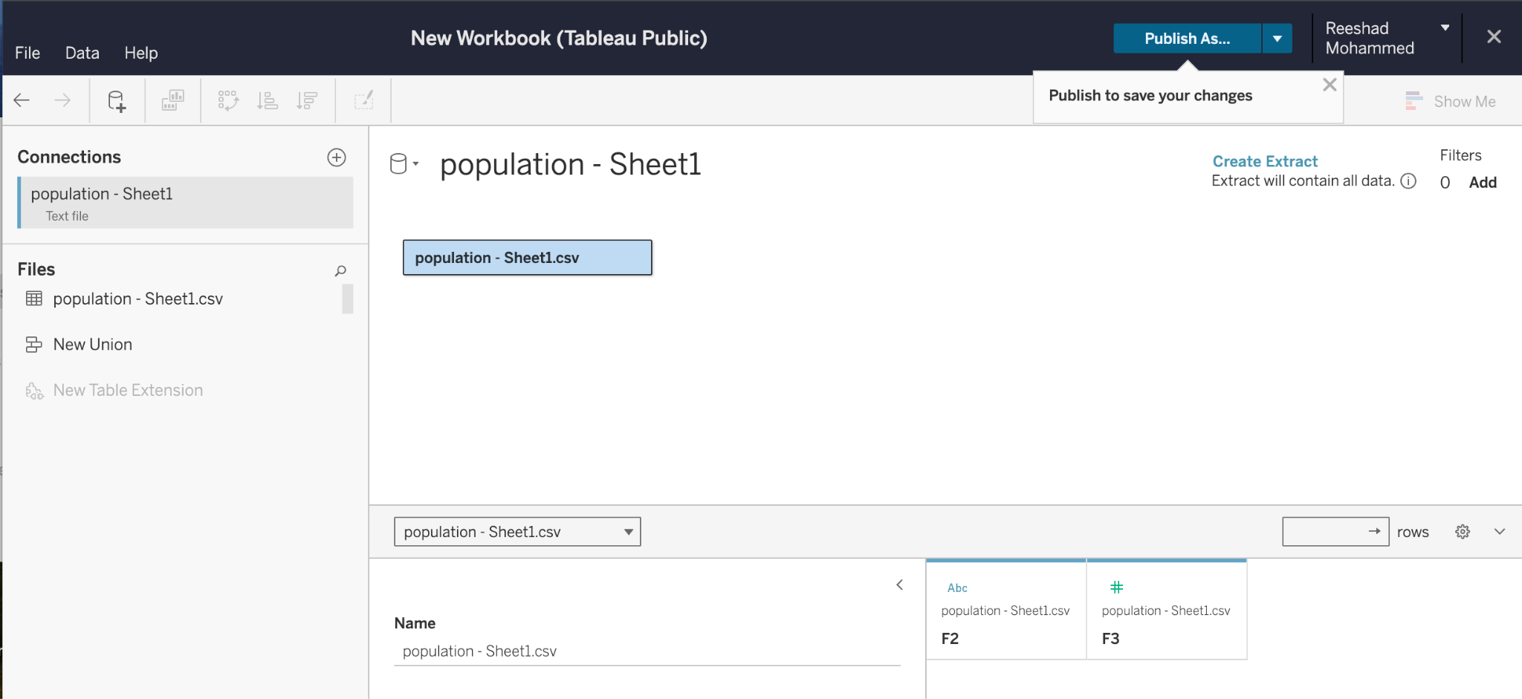
After logging in or creating a public account, go to the Create icon.
After hovering over create, press Web Authoring.
It will then tell you to connect data. Find the provided csv and attach it.
[UCLA might have free access, or extended free trial, need to check about this]

Slide 10
Tableau Desktop
If you have tableau Desktop, you should have the application on your computer and be able to open it.
The next slide will show roughly what it looks like after opening.

Slide 11
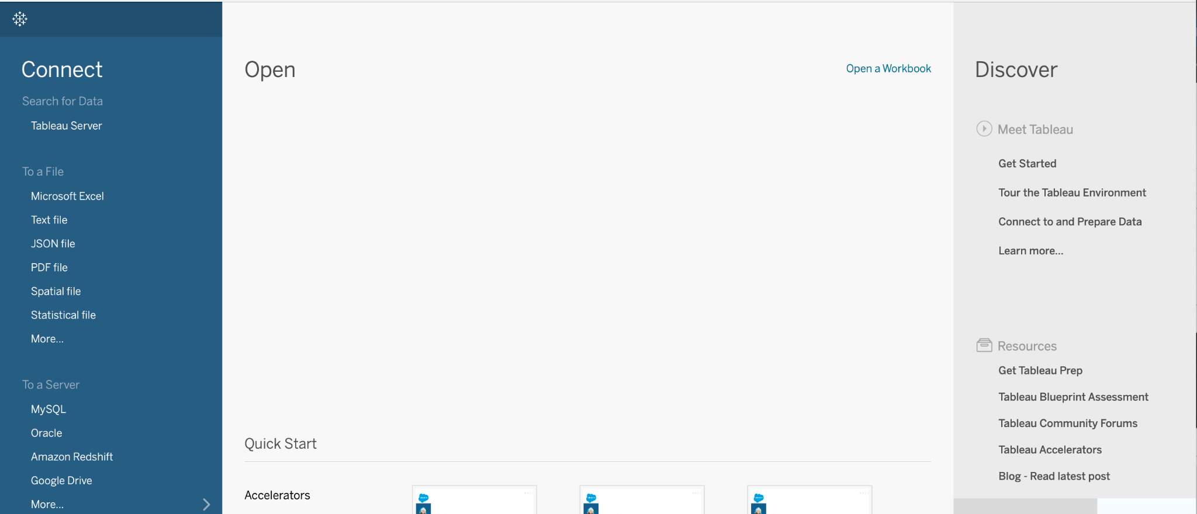
After logging in or creating a public account, go to the Create icon.
After hovering over create, press Web Authoring.
It will then tell you to connect data. Find the provided csv and attach it.
[UCLA might have free access, or extended free trial, need to check about this]

Slide 12
Workbook for Desktop
To open a worksheet, since we are using a csv file, go to the “To a File” column and find csv files. If not there, click More.
After clicking More, open the file directly from your computer.
The workbook should look similar to the Tableau Public workbooks.

Slide 13
Crash Course on Data Types
Binary:
Emphasis on two options
Typically characterized as 0 and 1
Often convert “true or false” and “yes or no” to binary
String:
Words and phrases
Typically have no innate numerical values
Integers:
Numbers without decimals
Both negative and positive, 0 included

Slide 14
Data Source
After creating the workbook, you will be on the data source page.
Drag and drop the csv into the large white space.
You should see a 2 column table with labels. These labels are important to see how Tableau interprets the structure of data
Data Type
Column Name

Slide 15
Kinds of Data
Nominal
Named categories
Categorical
(qualitative)
Ordinal
Ordered data
Data
Discrete
Integer values
Numerical
(quantitative)
Continuous
Any numerical value

Slide 16
Bar Chart
Make sure the column with states is in String Type, labeled ABC.
The column with population will be treated as numerical data, labeled #.
Either change the column names or keep them and remember which is which
Next open a sheet.
Put one of the columns in rows, and the other in columns. Play around with it to see the orientation you like. In marks select Bar.

Slide 17
Details
As you all get the bar charts ready, for those finished early, I’ll show some of the detail features such as color and orientation changes.
We can also play around with what happens with different graph types.
After a few minutes, we will move on to the map.The map will use the same data.

Slide 18
Map
Create a new sheet in the same workbook
Alternatively, make a new workbook with the same data opened up
In Tableau, for the states columns, change to states/province
In the dashboard, this will create latitude and longitude data
With this, a map can be made

Slide 19
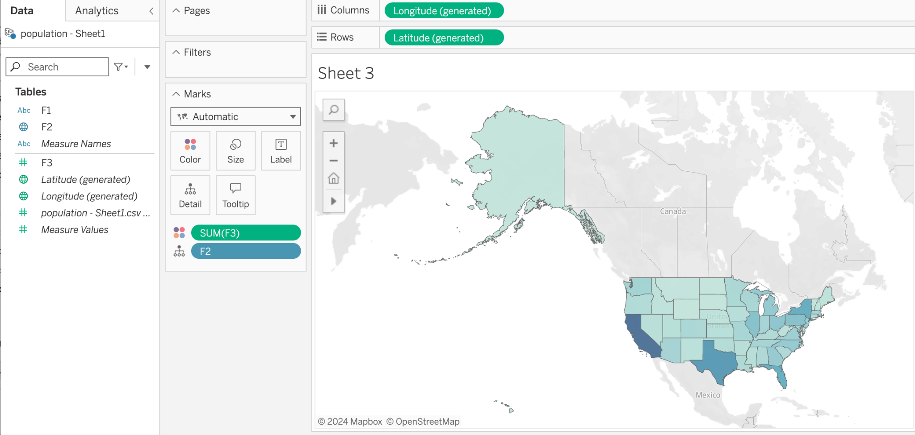

Slide 20
Google Sheets
For the previous example, I provided a csv file. What if you were working on another platform, or had your own data.
Often, people use sheets for quick data entry, so let's see how to convert sheets data to Tableau.
Note for sheets, you will need to allow Tableau to access Google Drive

Slide 21
Tableau through Sheets
I will go through an example using corvette colors to show you how to go from sheets to Tableau.
Feel free to use your own sheets dataset if you like.
Once at the worksheet, feel free to play around with different visualizations

Slide 22
Sheets
After cleaning the sheets data into colors on column one and number sold in column 2, go to Tableau.
In Public, go to connectors and drive. In Desktop, go to “To a Server” and search for Google Drive.
After finding the sheet you just made, open it and you will get a new workbook.

Slide 23
Challenge
Try to get the end result on the next page!

Slide 24
